Slide 1

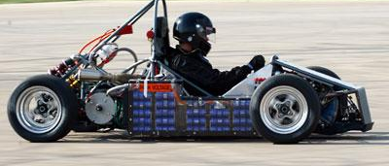
Team 505: SAE Hybrid Vehicle Battery Box and BMS
18-Jan-19

Slide 2





Team Introductions
William Pisani
ME
Raymond Klouda
ME
Thomas O’Neill
ME
Christopher Fishman
EE
Christian Gaya
CPE

Slide 3

Past Work
Christian Gaya

Slide 4

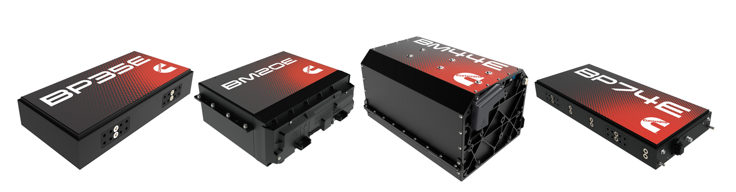
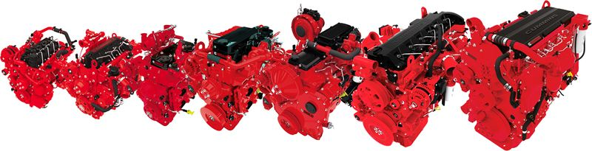
Project Re-Introduction
Objective
  Build a battery box and battery management system (BMS) for the SAE hybrid vehicle competition team
Sponsor
  An American Fortune 500 corporation that designs, manufactures, and distributes engines, filtration, and power generation products
  Leading innovation in electrified power on numerous applications especially class 8 semi-trucks
Christian Gaya

Slide 5
Previous Semester Work
Project Scope
Project Description
  A small model of the battery box and BMS for the SAE hybrid vehicle will be built
  A program will also be created that takes in arbitrary vehicle parameters and outputs the appropriate sizing of the battery system
Key Goals
  Compact battery container integrated into frame of vehicle
  Environmentally sustainable, waterproof, and thermally insulated
  BMS will measure battery charge, control power, and monitor current flow, voltage levels, and temperature
Assumptions
  Vehicle will have enough room for full-scale battery pack and box
  Rulebook will be the same for the year of the competition
  Chassis will remain the same for the year of the competition
Christian Gaya

Slide 6
Previous Semester Work (cont.)
Customer Needs
Interpreted Needs
  Design a program that takes in parameters about motors and outputs information about the battery system
  The battery box protects the battery, prevents overheating, and avoids environmental impact
  A small-scale prototype should be created with proper specifications
  BMS maintains charge control, cell balancing, and monitors power input and output
  Battery system for a momentary high-torque boost should be a focal point of the BMS system
  The battery box and BMS both adhere to SAE competition guidelines
Christian Gaya

Slide 7
Battery System
Battery Containment
Battery Management System
Support
Monitor
Integrate
Configure
Control
External Forces
Battery Load
Vehicle Chassis
Battery Layout
Temperature
Control
Charge
Current Flow
Voltage Level
Power Output
Batteries
Temperature
Previous Semester Work (cont.)
Functional Decomposition
Christian Gaya

Slide 8
Previous Semester
Work (cont.)​
Metric | Target | Unit
G-Force | 2 | G’s
Impact Resistant | Yes | N/A
Battery Weight | 8 | Lbs.
Compact | Yes | N/A
Battery Volume | 216 | In³
Internal Box Temperature | <60 | Celsius
Max Discharge Current | 500 | Amps
Battery Pack Voltage Level | 60 | Volts
Battery Cell Temperatures | <60 | Celsius
Power Output | 30 | kW
Input Voltage to Battery | 60 | Volts
Targets
Weight, discharge current, voltage level, power output, G-Force, and input voltage were all chosen in a performance-based perspective
With safety in mind, the impact resistance, box temperature, and cell temperatures were chosen carefully to maintain operation while mitigating risks
Christian Gaya

Slide 9
Previous Semester Work (cont.)
Concept Generation
Biomimicry
    Analytically apply our problem to nature and brainstorm nature's own solutions
Anti-Problem
    Project problems were reversed, and possible solutions to these anti-problems were found
Morphological Chart
    Lists functions and various mechanisms that can be used to perform the functions listed
    Includes the ideas we found from biomimicry, anti-problems, and the customer needs
    Lines can be used to connect the rows and columns of the chart. Each line represents a different possible concept
Raymond Klouda

Slide 10

Morphological Chart
Function | Option 1 | Option 2 | Option 3 | Option 4
Box Shape | Cube | Rectangle | Cross | T-Shape
Box Cooling | Liquid cooling | Air cooling (ventilation) | Fans
Box Waterproofing | Rubber seals | Water diversion | Silicon Sealant | Vacuum Sealed
Box Mounting | Integrated into chassis | Bolted into chassis
Energy Storage Device | Individual ioncells | Purchase off shelf | Capacitor
Energy Storage Device Wiring | Series | Parallel | Both series and parallel
BMS Measurements | Current | Voltage | Temperature | All measurements
Current Type | AC | DC
Charging Device | Wall power | Solar | Regeneration
Function | Option 1 | Option 2 | Option 3 | Option 4
Box Shape | Cube | Rectangle | Cross | T-Shape
Box Cooling | Liquid cooling | Air cooling (ventilation) | Fans
Box Waterproofing | Rubber seals | Water diversion | Silicon Sealant | Vacuum Sealed
Box Mounting | Integrated into chassis | Bolted into chassis
Energy Storage Device | Individual ion-cells | Purchase off shelf | Capacitor
Energy Storage Device Wiring | Series | Parallel | Both series and parallel
BMS Measurements | Current | Voltage | Temperature | All measurements
Current Type | AC | DC
Charging Device | Wall power | Solar | Regeneration
Raymond Klouda

Slide 11
Previous Semester Work (cont.)
Concept Selection
House of Quality
  Compared customer requirements to engineering characteristics (evaluation criteria)
  Generated the proper evaluation criteria for the Pugh charts
Pugh Charts
  Determined most important design concepts based on the evaluation criteria through comparing each concept to a datum
Analytical Hierarchy Process
  “Mathy” way to make a decision
  Equations were used for each evaluation criteria and design concept
Raymond Klouda

Slide 12

Analytical Hierarchy Results
Using the multiple equations from the AHP process, we solved for a consistency ratio
  Aim for a consistency ratio of below 0.1
  Ours was 0.13
  Slight bias towards monitored parameters in BMS
  Crucial for proper operation and safety
Raymond Klouda

Slide 13
Top Design from AHP and Pugh Charts
Box Shape: Rectangle
Box Cooling: Liquid Cooling
Box Waterproofing: Rubber Seals
Box Mounting: Integrated into Chassis
Energy Storage Device: Purchase Off Shelf
Energy Storage Device Wiring: Wiring Included with Purchase
BMS Measurements: Temperature, Voltage, and Current
Current Type: DC
Charging Device: Wall Power
Raymond Klouda

Slide 14

Current Work
William Pisani

Slide 15
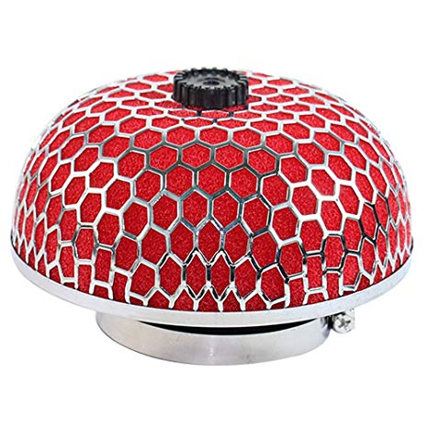
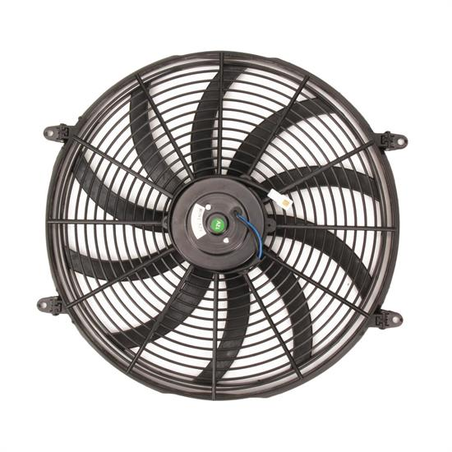
Changes to Physical Design
Discussions with Sponsor, Advisor, and college faculty
Liquid Cooling replaced with air cooling
  Fan and filter system
  Reduces overall cost
  Eliminates potential hazard of liquid reaching the batteries
"Integrated into chassis" replaced with bolted into chassis
  Hard to integrate into pre-existing chassis
  Easier access for system maintenance
William Pisani

Slide 16
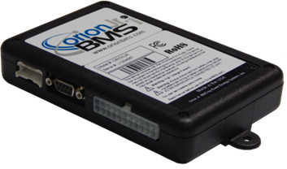
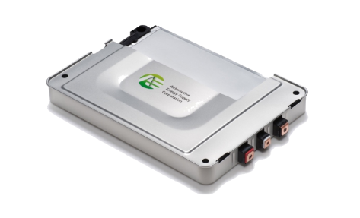
Cost Analysis for Final BoM
Decreasing aluminum 6061 thickness from 1/4" to 3/16"
  Reduces cost of aluminum
  Structural integrity will be tested to ensure there is no significant change
Orion Jr. BMS over Orion BMS (Original)
  Orion Jr. will be able to handle all the modules for prototype as well as the full-scale model
Purchase main components
  BMS and battery modules
William Pisani

Slide 17

Future Work
William Pisani

Slide 18
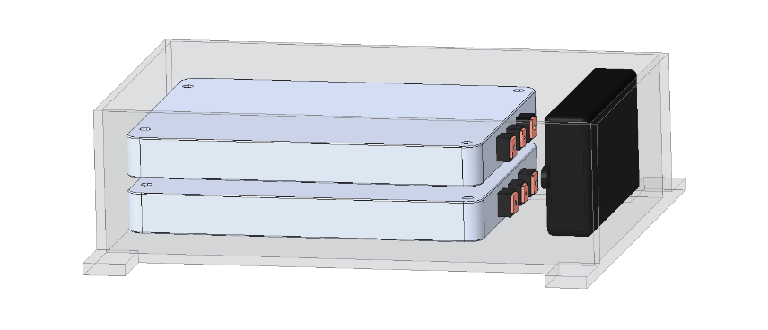
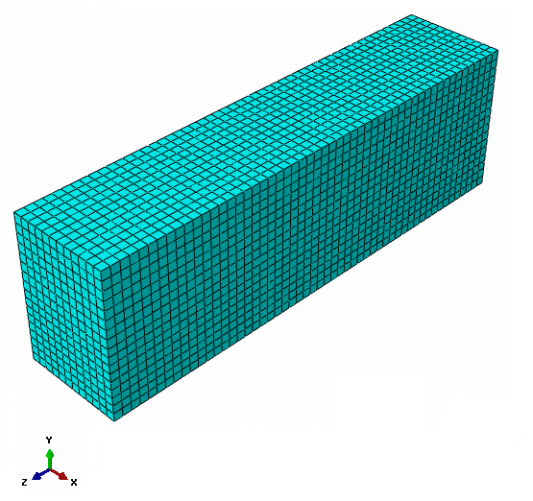
Finalize Design of System
Finalize design of prototype and full-scale model
  Welding and bolting of the box
  All components of system
Use CAD to develop Finite Element Analysis
  Thermal Analysis
  Structural Analysis
  Test with different material types
William Pisani

Slide 19
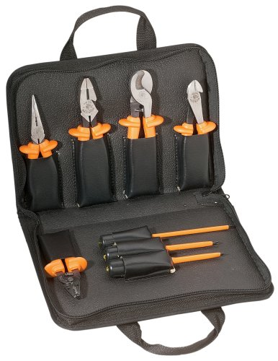
Begin Assembly
Finish ordering smaller components
  Box material
  Mounting hardware
  Wire
  Terminal connections
  Rubber Gaskets
  Tools
  DC Converter
  AC Converter
  Etc.
Assembly
  Integrate BMS with battery modules
William Pisani

Slide 20

References
Motors. (n.d.). Retrieved October 2, 2018, from http://www.evwest.com/catalog/index.php?cPath=8
Fuel Economy Retrieved October 2, 2018, from https://www.fueleconomy.gov/feg/hybridtech.shtml.
800hp Electric Pickup Retrieved October 3, 2018, from https://www.hardworkingtrucks.com/rivian-reveals-chassis-of-800-hp-electric-pickup/
Notes:
Not this slide will advance on default after 2 seconds. If you would like to change this then go to the transition tab and under timing change the advance slide settings.

Slide 21
Questions?

Slide 22
Backup Slides
Supporting Slides to the content above.

Slide 23
Question/Prompt | Customer Statement | Interpreted Need
Should we build a battery box specific to the current SAE hybrid vehicle? | I want to be able to provide parameters about the battery that the box is holding and get values returned about the size of the box. | A program should take parameters about a battery and output parameters about a battery box.
Should a physical model of the battery box be built? | The main item I'm looking for is the program that will give me values based on the battery. | The main item I'm looking for is the program that will give me values based on the battery.
What should the battery box protect from? | The container should be waterproof, thermally insulated, and environmentally sustainable. | The battery box protects the battery. The battery box prevents overheating of the battery. The battery box does not negatively impact the environment.
What should the BMS do? | The BMS will maintain charge control and cell balancing of the battery in a safe and efficient manner while also monitoring power input and output. | BMS maintains charge control, cell balancing, and monitors power input and output.
What battery are we using to create a BMS for? | Decide on a series of parallel battery. Whichever work best for the motor that is being used in the vehicle. | Battery system for a momentary high-torque boost should be focal point of the BMS system
Should we investigate building our own battery or buying one off the shelf? | Creating your own battery would be very difficult. I recommend buying one off the shelf and using that to create a BMS. | Battery will be purchased.
Do you think there are any restrictions to the battery box and BMS? | The SAE rulebook for the competition should contain all details about how the vehicles must be built. | The battery box and BMS both must adhere to SAE competition guidelines.

Slide 24
Part # | Part Name | Revision | Description | Specifications | Quantity | Unit of Measure | Unit Cost | Vendor Name | Ordered? | Estimated Delivery | Arrival Date | Maturity | Cost
295B9-3NF0A | Battery | A | Nissan Leaf battery pack to be used with the built battery management system | Single packs that will contain four cells each | 2 | Each | $ 85.00 | Miami hybrid | No | N/A | N/A | 0.38 | $ 170.00
1NYK7 | Aluminum 6061 Sheets | A | Will surround the battery to act as a protective box | 1/4 in x 24 in x 24 in | 3 | Each | $ 191.84 | Grainger | No | N/A | N/A | 0.38 | $ 575.52
8514K74 | Damping Material | A | Prevents damage to internal box components due to shock and vibration | 3/8 in x 24 in x 24 in | 1 | Each | $ 227.31 | McMaster-Carr | No | N/A | N/A | 0.38 | $ 227.31
CL-W019-OS00TR-A | Thermaltake Transparent Hose | A | Carrys the liquid coolant between the battery and the heat exchanger | Inside Diameter: 1/2"(13 mm ) Outside Diameter: 3/4"(19 mm) Length: 6.5' (200 cm) | 1 | m | $ 8.08 | Newegg.com | No | N/A | N/A | 0.38 | $ 8.08
 | Hose Fittings | A | Connect components (battery, heat exchanger, etc.) to hoses |  |  | Each |  | Lowes | No | N/A | N/A | 0.31 | $ -
 | Hose Clamps | A | Firmly retain hoses on hose fittings, prevents leaks |  |  | Each |  | Lowes | No | N/A | N/A | 0.31 | $ -
AF120 | Fan | A | Provides airflow over heat exchanger during low natural air flow conditions |  | 1 | Each |  | Newegg.com | No | N/A | N/A | 0.35 | $ -
 | Heat Exchanger | A | Rids heat from the coolant into the atmosphere |  | 1 | Each |  |  | No | N/A | N/A | 0.27 | $ -
392023004 | Bosch Water Pump | A | Carries coolant through cooling system loop | Auxiliary pump with gaskets and hardwear included | 1 | Each | $ 47.79 | RockAuto | No | N/A | N/A | 0.35 | $ 47.79
9268 | Battery Management System | A | Controls battery input and output prameters to maintain desired performance | Build to order | 1 | Each | $ 168.00 | AA Portable | No | N/A | N/A | 0.35 | $ 168.00
 | Microprocessor | A | Handles the functions of the water pump |  | 1 | Each |  |  | No | N/A | N/A | 0.27 | $ -
 | Wiring | A | Used to connect the microprocessor to batteries, resistors, thermistors, and voltmeters |  |  | Each |  |  | No | N/A | N/A | 0.27 | $ -
 | Resistors | A | Used in the BMS system |  |  | Each |  |  | No | N/A | N/A | 0.27 | $ -
 | Thermistors | A | measure battery temperature to relay to the BMS and ensure safe operating parameters |  |  | Each |  | Grainger | No | N/A | N/A | 0.31 | $ -
10G492 | Rubber Seals | A | Provides water diversion from sensitive electronic components interal to the box | 0.25" W, 25 ft L |  | Each | $ 24.50 | Grainger | No | N/A | N/A | 0.38 | $ -
 | Voltmeter | A | Measures voltage |  | 1 | Each |  |  | No | N/A | N/A | 0.27 | $ -
38HW82 | Esd Mat | A | Protective equipment to be used while working with electrical system | 4ft x 3ft, Thickness: 5/8" | 1 | Each | $ 211.47 | Grainger | No | N/A | N/A | 0.38 | $ 211.47
33525 | High Voltage Tool Kit | A | Protective equipment to be used while working with electrical system | Set of 13 basic insulated hand tools | 1 | Each | $ 926.00 | Grainger | No | N/A | N/A | 0.35 | $ 926.00
53PZ88 | High Voltage Face Mask | A | Protective equipment to be used while working with electrical system | Color: Lime | 2 | Each | $ 21.15 | Grainger | No | N/A | N/A | 0.38 | $ 42.30
4JD54 | High Voltage Gloves | A | Protective equipment to be used while working with electrical system | Class 00 | 1 | Each | $ 64.75 | Grainger | No | N/A | N/A | 0.38 | $ 64.75
 | Totals |  |  |  | 18 |  |  |  |  |  |  |  | $ 2,441.22

Slide 25
Methods of Generation
Biomimicry
  Analytically apply our problem to nature and brainstorm nature's own solutions
Anti-Problem
  Project problems were reversed, and possible solutions to these anti-problems were found
Morphological Chart
  Lists functions and various mechanisms that can be used to perform the functions listed
  Includes the ideas we found from biomimicry, anti-problems, and the customer needs
  Lines can be used to connect the rows and columns of the chart. Each line represents a different possible concept
Chris Fishman
Notes:
"Next, Anti-problem was used to generate concepts. In this method, the problem was reversed, and possible solutions and problems were created. For example, instead of trying to solve the problem “How will the batteries be cooled” the problem was stated as “How to keep the car from catching fire”. This method allowed us to see simple solutions we were previously missing."
- purpose is to help teams look at a problem in a different way and break out existing patterns.
- how do we keep batteries dry – versus- how do we stop water intrusion. OR, how do we charge the batteries – versus- what is going to be a realistic/feasible power supply.

Slide 26
Methods of Generation (cont.)
The main functions that were added to the morphological chart derive from the interpreted customer needs
By building a multi-option chart, it is possible to piece together many different combinations of the project functions
Generating a large volume of concepts provides a broad spectrum of options to later narrow down based on a weighted value system in the Concept Selection phase of the project
Chris Fishman

Slide 27
Morphological Chart
Function | Option 1 | Option 2 | Option 3 | Option 4
Box Shape | Cube | Rectangle | Cross | T-Shape
Box Cooling | Liquid cooling | Air cooling (ventilation) | Fans
Box Waterproofing | Rubber seals | Water diversion | Silicon Sealant | Vacuum Sealed
Box Mounting | Integrated into chassis | Bolted into chassis
Energy Storage Device | Individual ion-cells | Purchase off shelf | Capacitor
Energy Storage Device Wiring | Series | Parallel | Both series and parallel
BMS Measurements | Current | Voltage | Temperature | All measurements
Current Type | AC | DC
Charging Device | Wall power | Solar | Regeneration
Chris Fishman

Slide 28
Top Eight Concepts
Concept 1.
Box Shape: Rectangle, Box Cooling: Liquid Cooling, Box Waterproofing: Rubber Seals, Box Mounting: Integrated into Chassis, Energy Storage Device: Purchase Off Shelf, Energy Storage Device Wiring: Wiring Included with Purchase, BMS Measurements: Temperature, Voltage, and Current, Current Type: DC, Charging Device: Wall Power
Concept 2.
Box Shape: Rectangle, Box Cooling: Air Cooling, Box Waterproofing: Rubber Seals, Box Mounting: Integrated into Chassis, Energy Storage Device: Purchase Off Shelf, Energy Storage Device Wiring: Wiring Included with Purchase, BMS Measurements: Temperature, Voltage, and Current, Current Type: DC, Charging Device: Wall Power
Concept 3.
Box Shape: Rectangle, Box Cooling: Liquid Cooling, Box Waterproofing: Rubber Seals, Box Mounting: Bolted into Chassis, Energy Storage Device: Purchase Off Shelf, Energy Storage Device Wiring: Wiring Included with Purchase, BMS Measurements: Temperature, Voltage, and Current, Current Type: DC, Charging Device: Wall Power
Concept 4.
Box Shape: T-Shape, Box Cooling: Liquid Cooling, Box Waterproofing: Rubber Seals, Box Mounting: Integrated into Chassis, Energy Storage Device: Purchase Off Shelf, Energy Storage Device Wiring: Wiring Included with Purchase, BMS Measurements: Temperature, Voltage, and Current, Current Type: DC, Charging Device: Wall Power

Slide 29
Top Eight Concepts (cont.)
Concept 5.
Box Shape: Cube, Box Cooling: Liquid Cooling, Box Waterproofing: Silicon Sealant, Box Mounting: Integrated into Chassis, Energy Storage Device: Purchase Off Shelf, Energy Storage Device Wiring: Wiring Included with Purchase, BMS Measurements: Temperature, Voltage, and Current, Current Type: DC, Charging Device: Wall Power
Concept 6.
Box Shape: Rectangle, Box Cooling: Liquid Cooling, Box Waterproofing: Silicon Sealant Silicon Sealant, Box Mounting: Integrated into Chassis, Energy Storage Device: Purchase Off Shelf, Energy Storage Device Wiring: Wiring Included with Purchase, BMS Measurements: Temperature, Voltage, and Current, Current Type: DC, Charging Device: Wall Power
Concept 7.
Box Shape: Rectangle, Box Cooling: Liquid Cooling, Box Waterproofing: Rubber Seals, Box Mounting: Integrated into Chassis, Energy Storage Device: Build Using Ion-Cells, Energy Storage Device Wiring: Parallel, BMS Measurements: Temperature, Voltage, and Current, Current Type: DC, Charging Device: Wall Power
Concept 8.
Box Shape: Rectangle, Box Cooling: Liquid Cooling, Box Waterproofing: Rubber Seals, Box Mounting: Integrated into Chassis, Energy Storage Device: Build Using Capacitors, Energy Storage Device Wiring: Parallel, BMS Measurements: Temperature, Voltage, and Current, Current Type: DC, Charging Device: Wall Power

Slide 30
Comparison Matrix
Thomas O'Neill
Notes:
Comparison Matrix allowed us to determine the importance weight factors for each customer requirements to be used in HoQ.

Slide 31

House of Quality
Thomas O'Neill
Notes:
Using importance weight factors, we compared customer requirements to the engineering characteristics and determined how important each customer requirements is to each engineering characteristic. From this, relative weight of each engineering characteristic is found which allows us to find the rank orders.

Slide 32
Nine-Design Pugh Chart
Thomas O'Neill
Notes:
Compared our top 8 chosen design concepts to the selection criteria datum. Each design was rated against each selection criteria and given plus, minus, or satisfactory for each criteria. Everything was summed up and designs 3, 4, 5 scored the lowest and were eliminated.

Slide 33
Five-Design Pugh Chart
Thomas O'Neill
Notes:
The first step was to replace the datum. Here datum 1 was chosen but it didn’t matter which we chose as they all tied. From the results, design 1 seemed to be the best result in regards to number of pluses and minuses.

Slide 34

Analytical Hierarchy Process
Thomas O'Neill
Notes:
Here AHP, a very mathy method, was used to confirm our previous findings from the pugh charts. First we compared each characteristic to themselves and rate accordingly.

Slide 35
Analytical Hierarchy Process Normalized
Thomas O'Neill
Notes:
The vlues from the previous chart were calculated by normalizing each number using the sums from the previous chart. Criteria weights for each characteristic were found.

Slide 36
Analytical Hierarchy Process (cont.)
Thomas O’Neill
Notes:
AHP was then done for each characteristic compared to the top 3 designs we found from the pugh charts. Here are two examples, power and weight. The same process was followed as before.

Slide 37
Analytical Hierarchy Process (cont.)
Thomas O’Neill
Notes:
Using criteria weights found for every characteristic, we listed them in a matrix and calculated the alternative values for each design seen at the right. From these it shows that design 1 has the highest value which leads us to believe that design 1 once again is the best slide

Slide 38
Standard Shapes
Summary Box
Text box 1
Outlined Text Box

Slide 39


Approved Logos

Slide 40
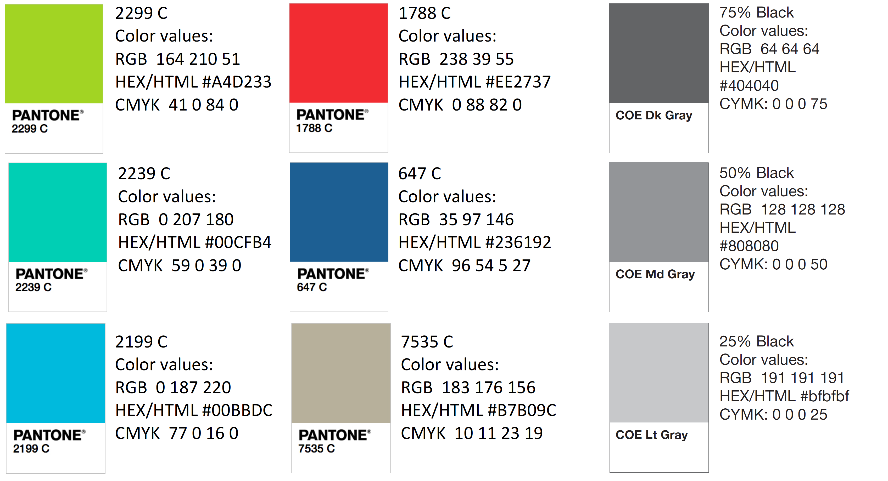
Color Palette

Slide 41
APA Tables
Category 1 | Category 2 | Category 3 | Category 4 | Category 5
Item 1
Item 2
Item 3
Item 4
 | Category 2 |  |  | Category 3
Category 1 | subcategory 1 | subcategory 2 |  | subcategory 1 | subcategory 2
Item 1
Item 2
Item 3
Item 4

